Slide 1


Multilayer Neural Networks
Hidden layers.
Recurrent neural networks,

Slide 2
Introduction
ANN is inspired by the biological neural network
These layers are categorized into three classes which are input, hidden, and output.
How do we know number of layers

Slide 3
Guidelines to know the number of hidden layers and neurons per each hidden layer in a classification problem
In artificial neural networks, hidden layers are required if and only if the data must be separated non-linearly.
Based on the data, draw an expected decision boundary to separate the classes.
Express the decision boundary as a set of lines. Note that the combination of such lines must yield to the decision boundary.
The number of selected lines represents the number of hidden neurons in the first hidden layer.
To connect the lines created by the previous layer, a new hidden layer is added. Note that a new hidden layer is added each time you need to create connections among the lines in the previous hidden layer.
The number of hidden neurons in each new hidden layer equals the number of connections to be made.

Slide 4
Example
Xor Problem
Each sample has two inputs and one output that represents the class label.
Classes are non-linearly separated.
A single line will not work.
As a result, we must use hidden layers in order to get the best decision boundary.
In such case, we may still not use hidden layers but this will affect the classification accuracy. So, it is better to use hidden layers.

Slide 5
first step is to draw the decision boundary that splits the two classes.
express the decision boundary by a set of lines.
The idea of representing the decision boundary using a set of lines comes from the fact that any ANN is built using the single layer perceptron as a building block. The single layer perceptron is a linear classifier which separates the classes using a line created according to the following equation:
y = w1*x1 + w2*x2 + ⋯ + wi*xi + b
Where x_i is the input, w_i is its weight, b is the bias, and y is the output.

Slide 6
Knowing that there are just two lines required to represent the decision boundary tells us that the first hidden layer will have two hidden neurons.
Up to this point, we have a single hidden layer with two hidden neurons. Each hidden neuron could be regarded as a linear classifier that is represented as a line.
outputs of the two hidden neurons are to be merged into a single output

Slide 7
Recurrent neural networks
Feed forward network outputs are independent of each other.
Ex-classifying images
Rnn-book

Slide 8
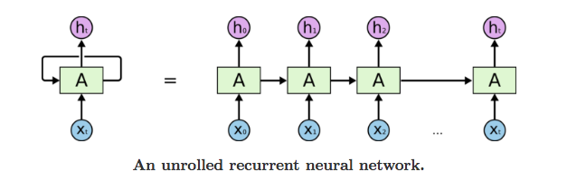

Slide 9
apple
Apple
yesterday
Orange
yesterday
orange
Banana
yesterday
banana

Slide 10
Predicted Apple yesterday
Predicted Orange yesterday
Predicted Banana yesterday
Apple
Orange
Apple yesterday
Banana
Orange yesterday
Banana yesterday

Slide 11
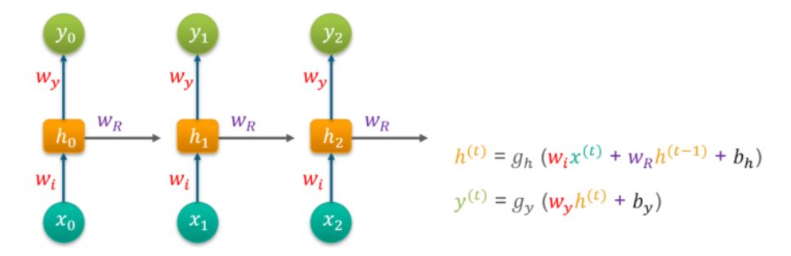

Slide 12
Training recurrent neural network
Uses back propagation through time.BTT
Some issues with back propagation:
Vanishing gradient
Truncated BTT
Clip gradient at threshold
Exploding gradient
ReLU activation function.
LSTM.

